Slide 1

Web Applications Development with .NET Framework and ASP.NET
Course Introduction
Svetlin Nakov
Telerik Corporation
www.telerik.com

Slide 2

About the Course
Web Applications Development with .NET Framework and ASP.NET objectives
Provides basic skills for development of dynamic data-driven ASP.NET Web applications
C# language fundamentals
Databases and SQL Server
LINQ and LINQ-to-SQL
ASP.NET and AJAX

Slide 3



Requirements to the Students
Computer programming skills
One of the following languages:
C#, Java or C++
Object-oriented programming
Abstraction, encapsulation, inheritance, polymorphism, exceptions handling
English language
All training materials are in English (intentionally, Telerik Academy policy)

Slide 4

Course Schedule
Sofia University – FMI
Every Wednesday, 18:00-21:00, lab 229
Start: 6 October 2010
Technical University – Sofia
Every Monday, 18:00-21:00, lab ???
Start: ???

Slide 5

Course Curriculum

Slide 6
Curriculum
.NET Framework Overview
.NET, CLR, MSIL, Assemblies, CTS, .NET languages
C# Language Overview – Part I
Data Types, Operators, Expressions, Statements, Console I/O, if / switch / case, Loops, Arrays, Methods
C# Language Overview – Part II
Creating and Using Objects, Exceptions, Strings, Generics, Collections, Attributes
Object-Oriented Programming with C#
Defining Classes, Constructors, Properties, Methods, Events, Interfaces, Inheritance, Polymorphism

Slide 7
Curriculum (2)
Databases, SQL and MS SQL Server
RDBMS, SQL Language, SQL SELECT, Joins, Grouping, SQL INSERT, SQL UPDATE, SQL DELETE, MS SQL Server, SQL Server Management Studio
LINQ and LINQ-to-SQL
LINQ Operators and Expressions, Projections, Conversions, Aggregations, LINQ-to-SQL, Using DataContext to Read / Create / Update / Delete Data
Web Technologies Basics
HTTP, HTML, Text, Images, Tables, Forms, CSS, JavaScript

Slide 8
Curriculum (3)
ASP.NET – Part I
ASP.NET Web Forms, Web Server Controls, HTML Server Controls, Creating Simple Web Applications
ASP.NET – Part II
Data-Bound Controls: Data Sources, GridView, FormView, DetailsView, DataList, Repeater, ListView
ASP.NET – Part III
Session and State Management, Master Pages and Navigation, User Controls, Web.config, IIS
ASP.NET AJAX
ScriptManager, UpdatePanel, AJAX Control Toolkit

Slide 9
Curriculum (4)
Silverlight and RIA
XAML, Text, Images, Graphics, Shapes, Creating Silverlight Applications, Text Controls, Buttons, List Controls, Data Binding and Data-Bound Controls
Practical Project
Creating Dynamic Rich-Data ASP.NET Web Application: Step-by-Step Live Demo
Additional Topic #1
Student will Suggest Interesting Topics
Additional Topic #1
Certification Exam

Slide 10

The Trainers Team

Slide 11
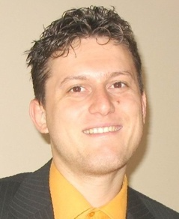
Trainers Team
Svetlin Nakov
Manager Technical Training, Telerik Corporation, Telerik Academy
15 years software development experience
E-mail: svetlin.nakov [at] telerik.com
Web site: www.nakov.com
Blog: http://nakov.com/blog/

Slide 12
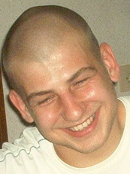
Trainers Team (2)
Mihail Stoynov
Technical Lead, Materna Bulgaria, www.materna.com
E-mail: mihail [at] stoynov.com
Blog: http://mihail.stoynov.com/blog/

Slide 13
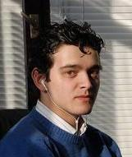
Trainers Team (3)
Branislav Abadjimarinov
Senior .NET Developer, ProPeople, www.propeople.dk
E-mail: brannislav [at] gmail.com
Blog: http://abadjimarinov.net

Slide 14
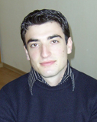
Trainers Team (4)
Ventsislav Popov
Developer, Crossroad, www.crossroad.bg
E-mail: ventsy.popov [at] gmail.com

Slide 15

Trainers Team (5)
Ivaylo Bratoev
Software engineer, Telerik Corporation, www.telerik.com
E-mail: ivaylo.bratoev [at] telerik.com
Blog: http://blogs.telerik.com/ivaylobratoev/

Slide 16

Trainers Team (6)
Svetlin Ralchev
Software engineer, Telerik Corporation, www.telerik.com
E-mail: svetlin.ralchev [at] telerik.com
Blog: http://blog.ralch.com

Slide 17

Trainers Team (7)
Ivaylo Hristov
Managing partner, Komfo Bulgaria, www.komfo.bg
E-mail: mail [at] ivaylo-hristov.net
Blog: http://ivaylo-hristov.net

Slide 18


Assessment
Exams, Grades, Certifications, Awards

Slide 19

Assessment
Practical project
Dynamic Web application – developed at home
Based on .NET Framework, ASP.NET Web Forms, SQL Server and LINQ-to-SQL
Examples:
Photo album
CMS system
Blog system
Dating site

Slide 20

Assessment (2)
Defending the projects
Students should defend their projects in class
Will be asked to extend the existing functionality
Using own laptop is recommended
Each project gets 0…60 scores
Score | Grade
51-60 | Excellent (6)
41-50 | Very Good (5)
31-40 | Good (4)
21-30 | Average (3)

Slide 21

Certification and Awards
Best students will get certification and awards
Certificate of achievement
Requires 51 score from the practical project
Issued by Telerik Academy
Signed by the trainers team
Awards
Remarkable results
Top 5-10 students
Sponsor:

Slide 22

Recommended Books

Slide 23


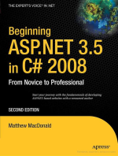
Recommended Books
Nakov S. & Co., Programming for .NET Framework, Volume 1, ISBN 954-775-505-6, www.devbg.org/dotnetbook/
Nakov S. & Co., Programming for .NET Framework, Volume 2, ISBN 954-775-672-9, www.devbg.org/dotnetbook/
MacDonald M., Beginning ASP.NET 3.5 in C# 2008 – From Novice to Professional, APress, ISBN 978-1-59059-891-7, http://tiny.cc/vk4Q0

Slide 24
Web Applications Development with .NET Framework and ASP.NET
?
?
?
?
?
Questions?
?
?
?
?
?
http://aspnetcourse.telerik.com

